Slide 1
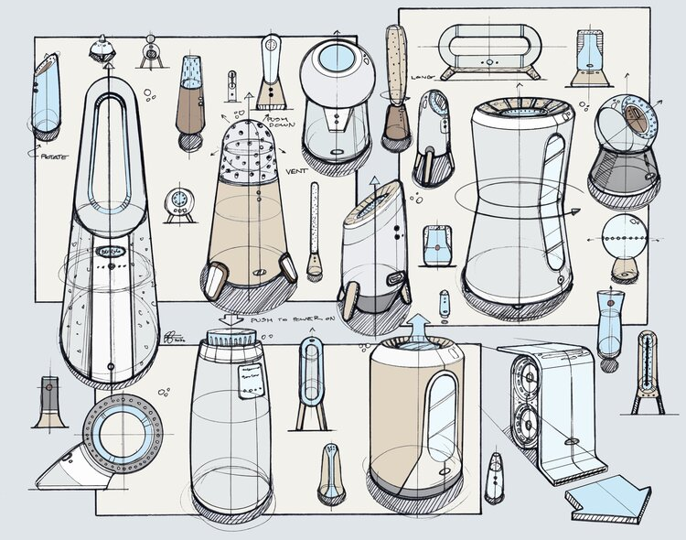
higher Design & Manufacture
Design Development

Slide 2
Learning intentions & success criteria
Learning Intentions
Introduction to Design Development.
Success Criteria
Understand the purpose of design development.
Implement your knowledge, understanding and skills to create a design development.

Slide 3
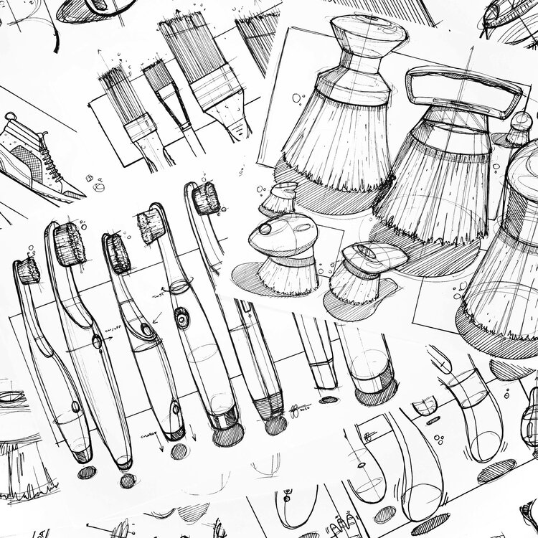
Design development
Initial ideas are generated quickly with some regard given for the design specification.
Further work is required to bring them in line with the specification and generate the level of detail required to permit manufacture.
Development is the evolution of the design from its initial idea to the final design proposal.

Slide 4
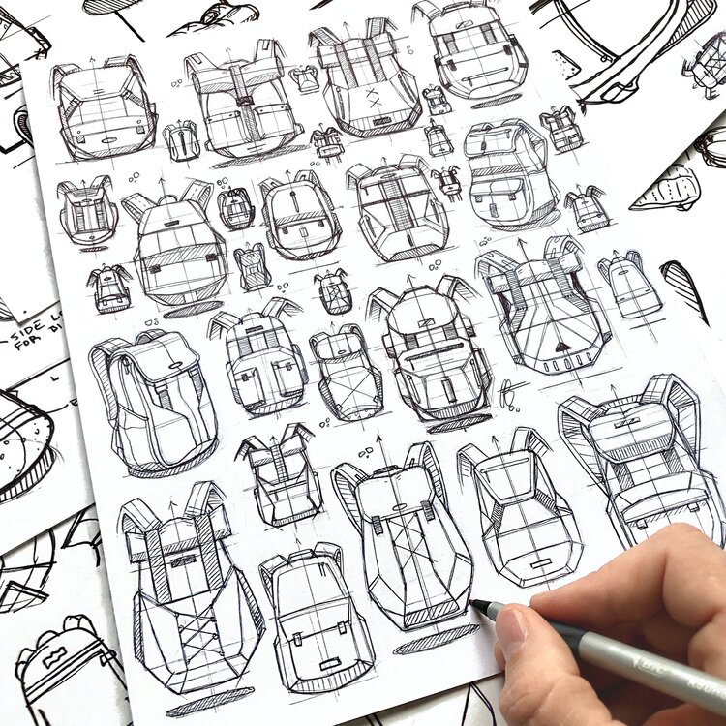
Design development
Development requires two key skills:
Exploring
Refining
The designer considers the most promising idea referencing the design specification.
This highlights areas for improvement.
Exploration of these areas takes place and the designer generates alternate solutions to improve them.
Further use of idea generation techniques will help the designer to be creative in the exploration of solutions.

Slide 5
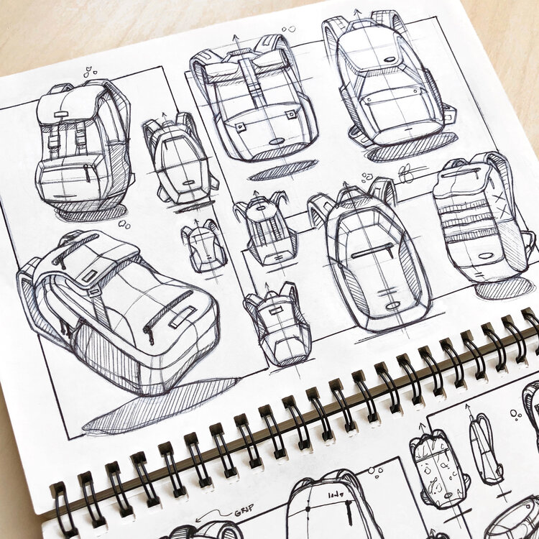
Design development
Potential solutions are investigated, tested and evaluated, with the most promising being further developed and incorporated into the design.
This leads to the narrowing down and refinement of solutions.
More specific details such as:
Sizes
Costs
Materials
Suitability for manufacturing.
…are also likely to be tested and evaluated before being confirmed as the development progresses.

Slide 6
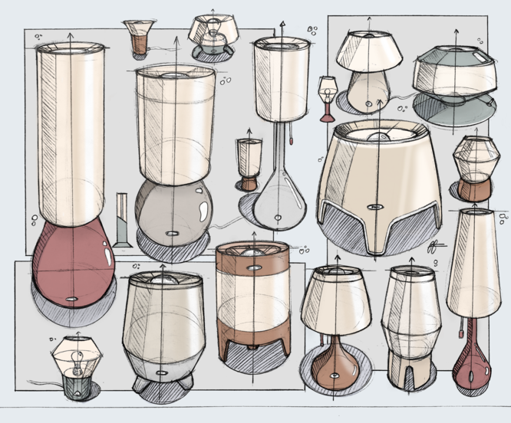
Design development
Exploring and refining should NOT be viewed as a linear process.
It is likely that, in refining an idea, further problems or areas for improvement will arise.
For example:
Changes to improve function will likely raise issues with aesthetics, materials and manufacturing.
These new issues will require exploring, testing, evaluating and refining.

Slide 7
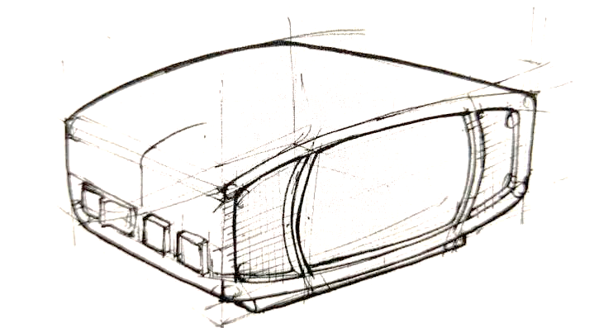
Skill builder task
An initial idea for an alarm clock is shown below. Take a few minutes to list as many possible areas for development that would make it more suitable for the teenage market.
ANSWERS MAY INCLUDE:
Dock for music player
Touchscreen technology
Link to other devices
Different colour combinations
A theme that appeals to teenagers
Less symmetrical form, change the position of the buttons to make them easer to access and press.

Slide 8
exploring
Exploring requires the effective application of divergent thinking and problem solving.
Focus, at this point, is on generating, testing and evaluating different solutions that address any issues with the initial idea.
Idea generation techniques such as SCAMPER can help.

Slide 9
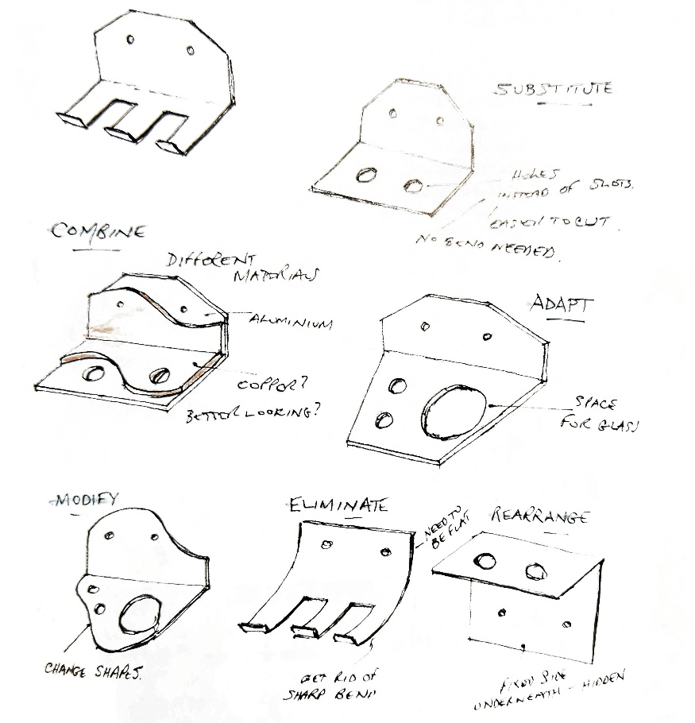
scamper
S – Substitute
Substitute one thing for another. For example, replace a part of a product, replace the material used or the process the product carries out.
C – Combine
Combine with another function of the product, combine materials or things. For example, combine two very different functions in one product, combine unusual parts with other products or ideas to create a new design.
A – Adapt
Adapt an existing idea, for example, adapt an existing product on the market, or a process or idea so that is can be used for other functions and processes.

Slide 10
scamper
M – Modify
Modify elements or part of the design. For example, make components a different size: larger, smaller or modify their structure to make them stronger.
P – Put to another use
Consider other uses for the product as well as other people who might use the product in a different way.
E – Eliminate
Eliminate some parts of the design by simplifying, reducing or removing non-essential components to change the product.
R – Rearrange
Rearrange sections of the product by reversing, rotating or moving different component parts about in various positions.

Slide 11
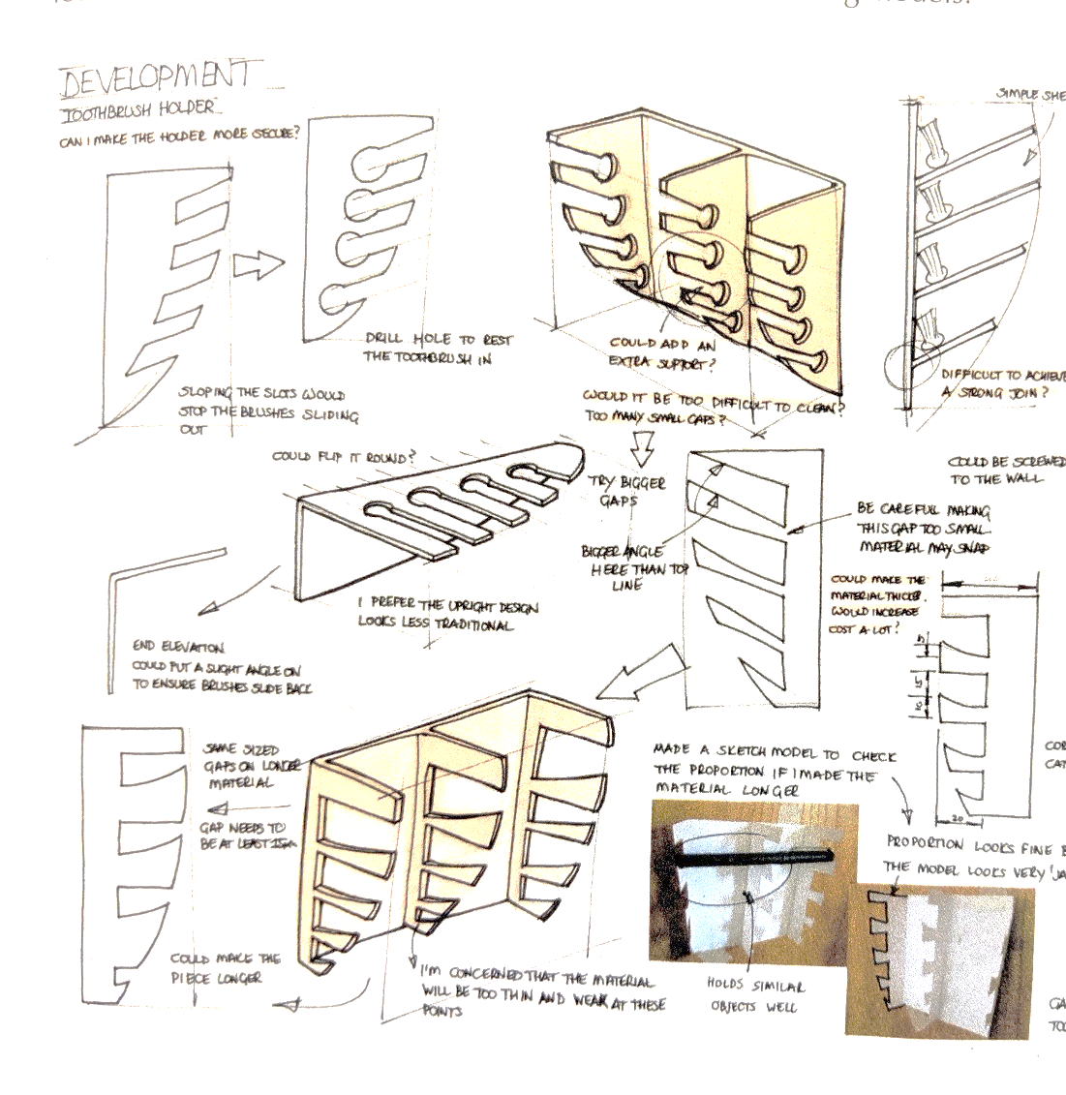
Exploration in action
Some exploration can be subtle and limited to simples changes in the shape.
Other changes can be more detailed, tested through models.
This allows the designer to effectively evaluate the proposed improvement.
Exploring your design in different views, for example going from 2D to 3D, may highlight new problems which require a solution.

Slide 12
refining
Refining requires convergent, analytical thinking.
The focus is on making decisions and providing enough detail to permit the manufacture of the product.
The range of solutions and information generated from exploring is narrowed down or synthesised, tested and evaluated.
Effective refinement leads to a design that meets the specification.
Materials and manufacturing processes will be suitable and justified.

Slide 13
Key points
Being able to apply knowledge and understanding of design issues and materials and manufacturing processes is key to effective refinement.
Even in later stages of development, designers still encounter issues that require further investigation.
As you develop, you must record more intricate details such as:
Sizes of components
Materials choices
Manufacturing processes needed.

Slide 14
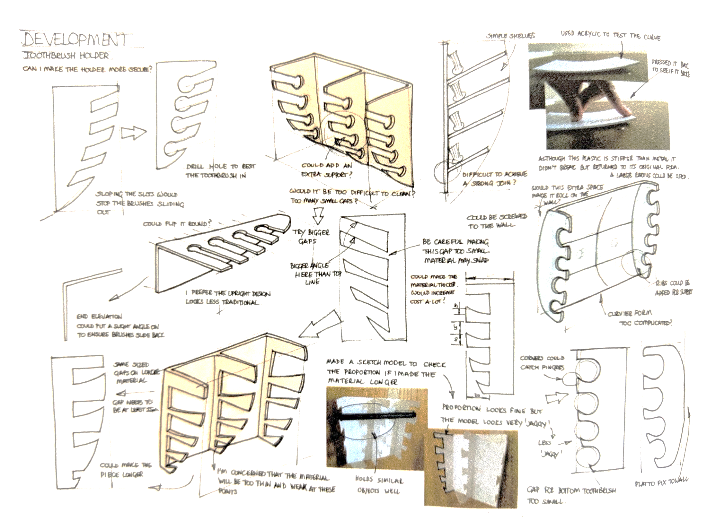

Slide 15
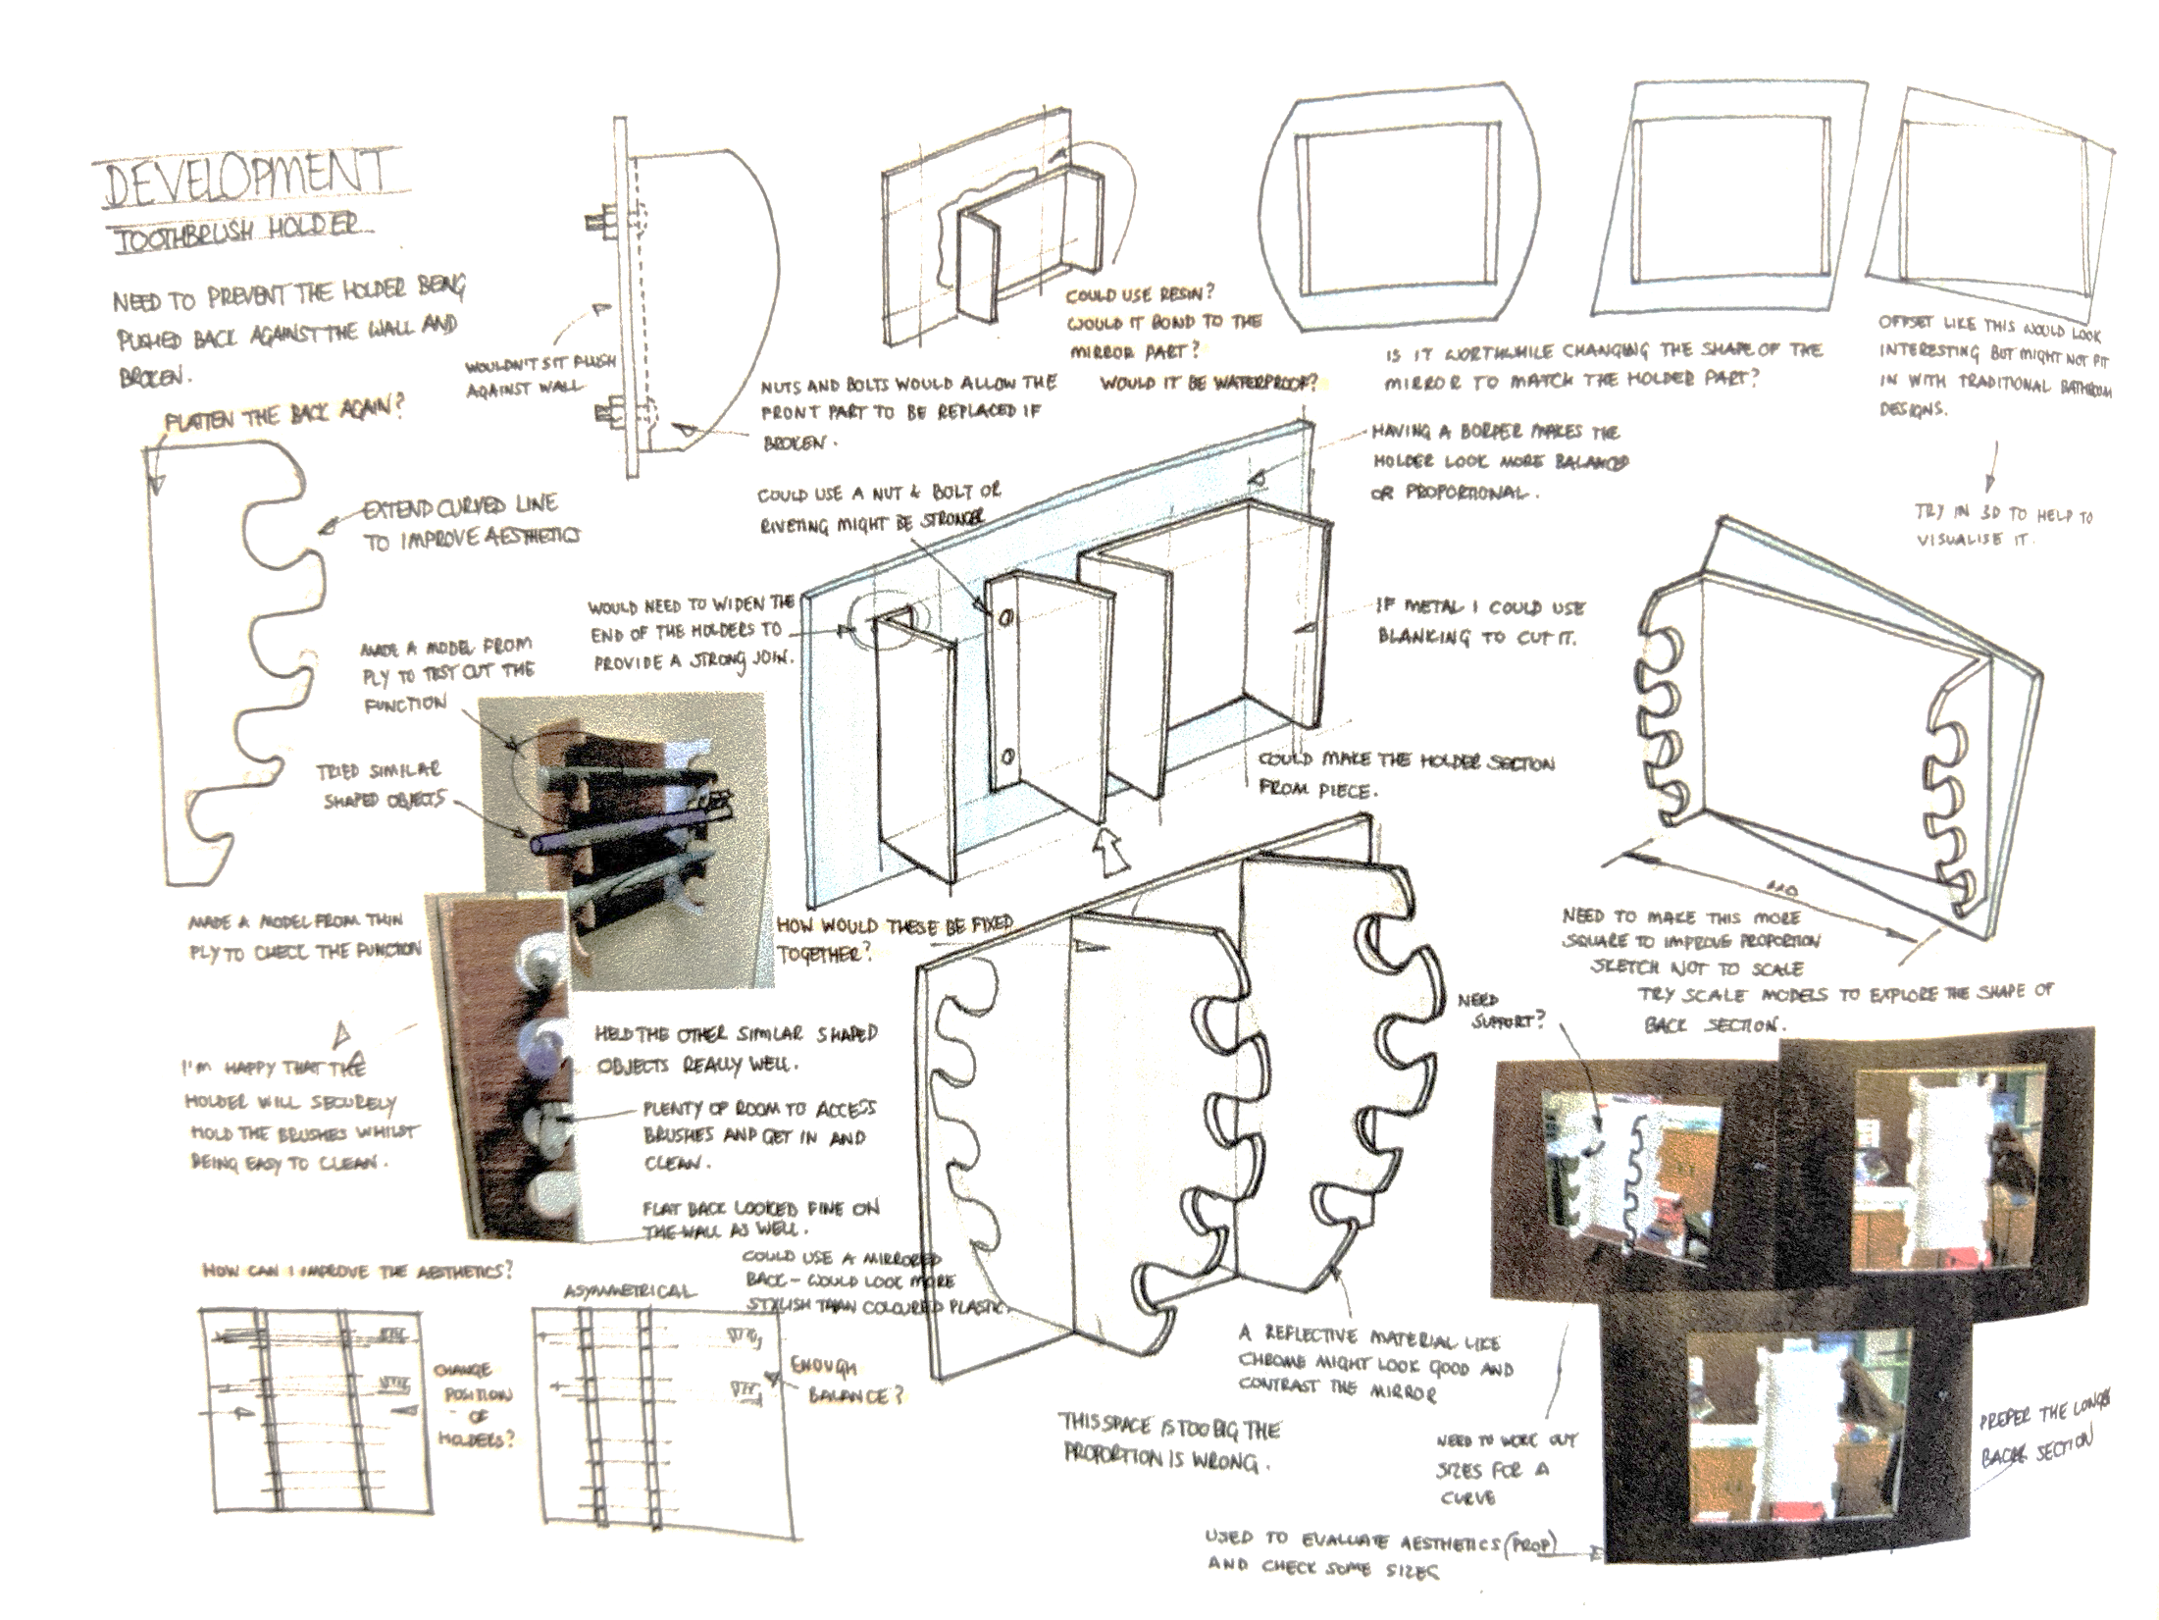

Slide 17
